Slide 1


JOB DATA SCRAPPING AND ANALYSIS FOR SOME TECHNOLOGY JOB
Group 4

Slide 2
Project Description
Brief description of the project

Slide 3
Introduction
The job market, particularly in the technology sector, is constantly evolving with new opportunities and requirements emerging regularly. Job seekers, employers, and recruiters often face challenges in keeping up with the rapidly changing landscape. Traditional job search methods may not offer adequate insights to make informed decisions.
This project aims to address these challenges by developing a data-driven system that collects and analyzes job-related data from various UK job websites.
By focusing on technology jobs, the project seeks to provide valuable insights into salary trends, required skills, and job requirements, empowering stakeholders to make informed decisions and streamline the recruitment process in the technology job market.
Through cutting-edge data analysis and visualization, this project aims to revolutionize the job market by fostering a more efficient and informed ecosystem for all stakeholders involved.

Slide 4
Project Overview
This project aims to develop a data scraping and analysis system focusing on technology jobs in the UK.
The system will analyze salary rates, required skills, and job requirements by collecting job-related information from various UK job websites.
The goal is to provide valuable insights to job seekers, employers, and recruiters, enabling informed decision-making in the dynamic technology job market.
The project will be executed by a collaborative team of professionals over a 7-week timeline, delivering a user-friendly web-based interface for accessing and interacting with the analyzed job data.

Slide 5

Project Objectives
Develop a web scraping module to extract job-related data from diverse UK job websites, including salary rates, required skills, and job descriptions.
Design and implement an efficient database schema to store the collected job data, ensuring data integrity and security.
Utilize Python libraries for exploratory data analysis (EDA) to identify trends and patterns in salary rates, skills, and job requirements for various technology job roles.
Create clear and informative visualizations to present the analysis results for better understanding and interpretation.
Develop a user-friendly web-based interface with search functionality, enabling users to access and interact with the analyzed job data efficiently.
Provide valuable insights to job seekers, employers, and recruiters, enabling them to make well-informed decisions in the UK technology job market.

Slide 6
Business Requirement Document
Functional Requirements
Data Scraping and Collection
Data Cleaning and Preprocessing
Data Analysis and Visualization:
User Interface Development
Extract job-related data from various UK job websites, including job titles, salary rates, required skills, job descriptions, and company details.
Customization of scraping parameters to accommodate different job websites and their data structures.
Clean and standardize the scraped data to ensure consistency and accuracy.
Preprocess the data to handle missing values and remove duplicates
Analyze salary rates to determine average, minimum, and maximum salaries for different job roles.
Identify common skills required for specific job positions.
Analyze job requirements and results through visualizations tools.
Provide search functionality for users to find specific job information.
Display relevant statistics, charts, and insights to assist users in making informed decisions.
User-friendly and intuitive for easy navigation and interaction.

Slide 7
NON-FUNCTIONAL REQUIREMENTS
PERFORMANCE
RELIABILITY AND ADAPTABILITY
Handle a large volume of data and processing data scraping requests efficiently.
The data analysis and visualization processes shall be optimized for performance to provide quick insights.
Maintain high availability to ensure users can access the platform without significant downtime.
The system shall have robust error handling and recovery mechanisms to prevent data loss and ensure reliability.
6
1
SCALABILITY
SECURITY & DATA PRIVACY
Privacy and security of user data, adhering to data protection regulations and industry best practices.
Access to sensitive data shall be restricted to authorized personnel only.
.
Scalable to accommodate potential growth in data and user demands.
Handle the increasing number of job websites and technology job categories
5
2
4
3
USABILITY AND USER EXPERIENCE
CAPABILITY & DATA ACURACY
The user interface shall be responsive and accessible across different devices and browsers.
The system shall provide clear instructions and user guidance to facilitate ease of use.
.
Compatible with various web browsers and operating systems commonly used by users.
The system shall ensure data accuracy and consistency throughout the scraping, preprocessing, and analysis processes.

Slide 8
PROJECT CHALLENGES & MITIGATIONS
Identified Challenges and Mitigation Strategies
Data Source Inconsistency
Website Changes
Data Privacy and Legal Compliance
Technical Challenges
Develop a robust data scraping module
Regularly review and update the scraping module
Monitor targeted job websites for any updates or changes .
Maintain a backup of previous website configurations
Ensure compliance privacy regulations for data scaping.
Encrypt sensitive data during storage and transmission to protect user information.
Conduct thorough testing and debugging .
Experienced technical experts to resolve technical challenges promptly.
Data Quality Risk
User Interface Acceptance
Stakeholders’ Expectations
Resource Constraints
Implement data validation and cleaning mechanisms .
Conduct regular data quality checks
Involve end users in the design and testing of the web-based interface.
Conduct usability testing to identify and address any usability issues.
Manage stakeholders expectations and provide progress updates.
Clearly communicate project scope and deliverables
Prioritize critical tasks and allocate resources effectively.
Collaborate with external experts if needed.

Slide 9
PROJECT CHALLENGES & MITIGATIONS
Identified Challenges and Mitigation Strategies
Time Constraints
Scope Creep
Create a realistic project timeline, considering potential delays and contingencies.
Regularly monitor project progress and adjust as needed to meet deadlines.
Document and communicate any changes to project scope through proper change management procedures.
Evaluate the impact of scope changes on the project timeline and resources before approving them.
External Dependencies
Data Security Breach
Establish communication channels with data providers and monitor data availability and quality.
Have alternative data sources identified in case of data unavailability.
Implement robust data security measures,
Educate team members about data security best practices

Slide 10
STAKEHOLDER ANALYSIS MATRIX
High
Keep Informed
Project Managers
Keep Satisfied
Project Sponsor
POWER
Manage Closely
Data Engineer
Data Scientist
Monitor with Minimal Efforts
Data Providers
Employee
Employer
Recruiter
Low
Low
IMPACT
High

Slide 11
RACI Matrix
Task | Project Manager | Business Analyst | Data Engineer | Data Scientist
Define Objectives | A | R | C | I
Create Documents | I | R, A | C | C
Data scrapping & Extraction | I | A | R | C
Data Cleaning | I | A | R | C
Data Storage | I | A | R | C
Data Analysis | I | A | C | R
Business Insights & Recommendation | I | A | C | R
RACI Matrix
R= Responsible
A= Accountability
C= Consulted
I= Informed

Slide 12
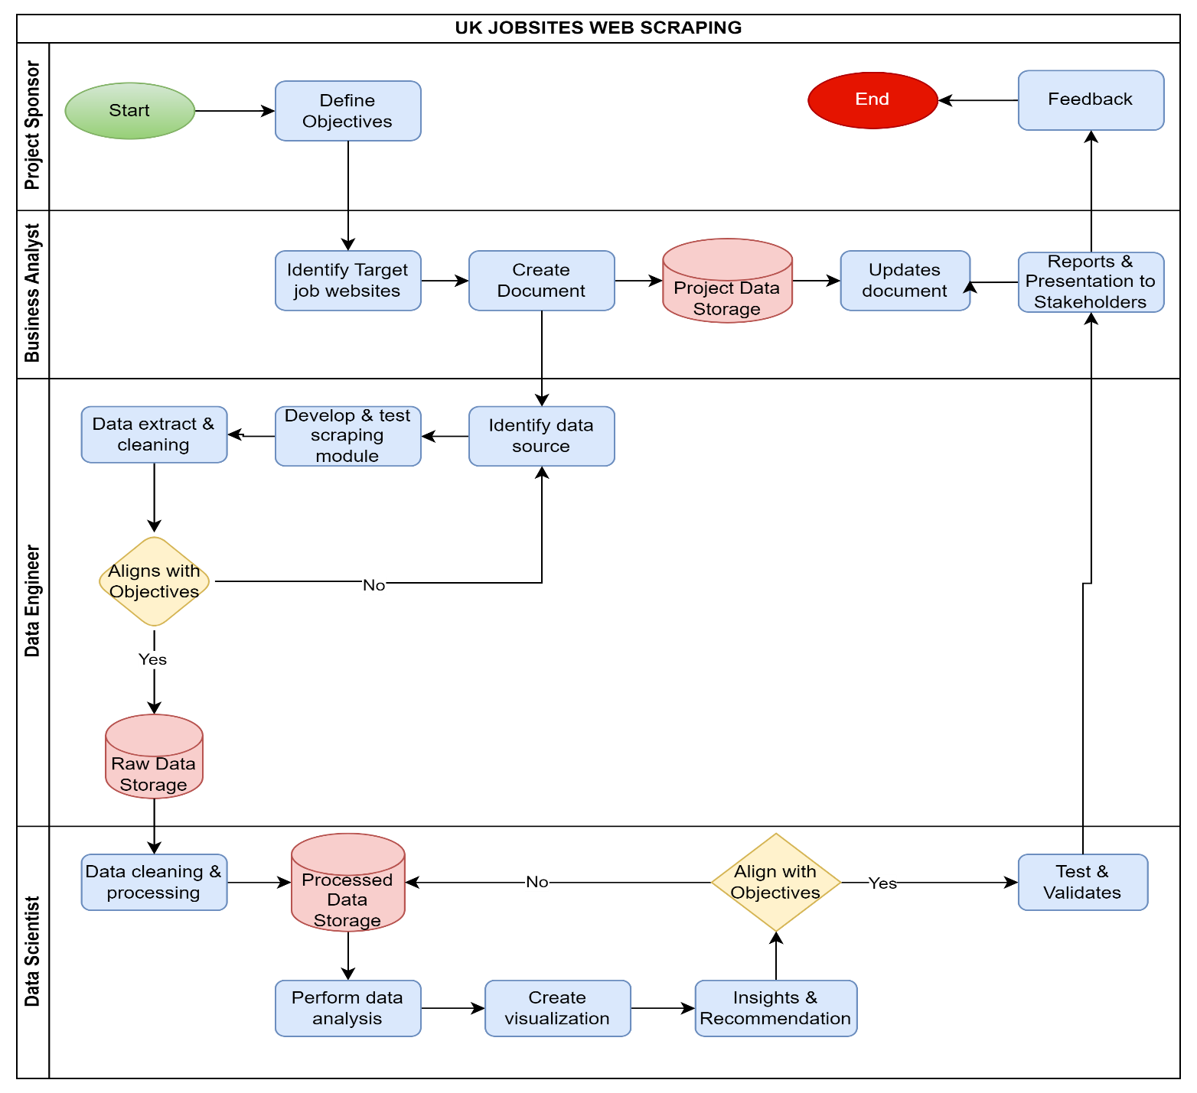
Process Map

Slide 13
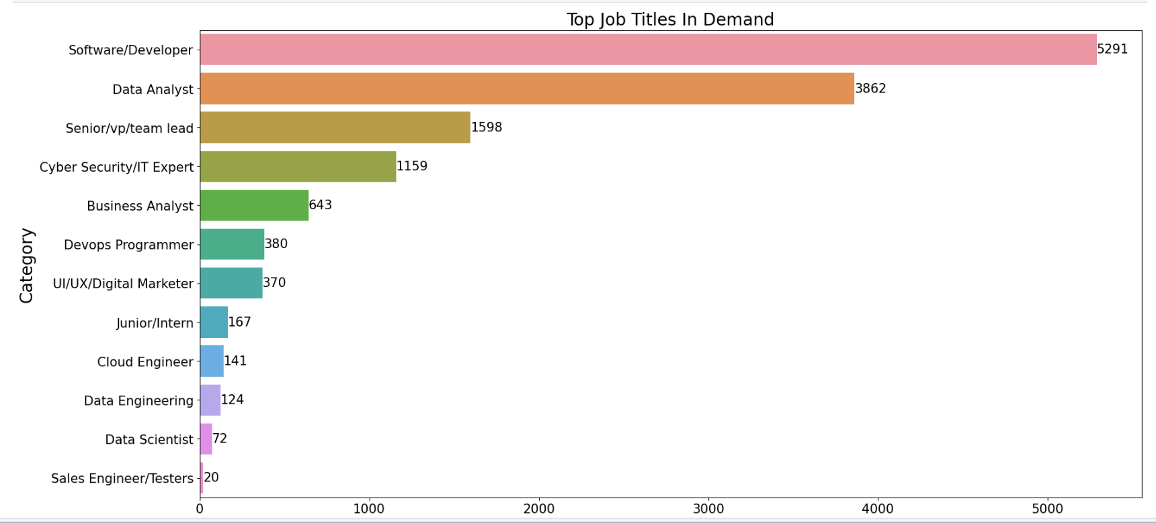
Job Title in Demand
Insights
Software Developer shows to have the highest job in demand across all categories.
Sales Engineer/Tester is least job in demand within tech job category

Slide 14
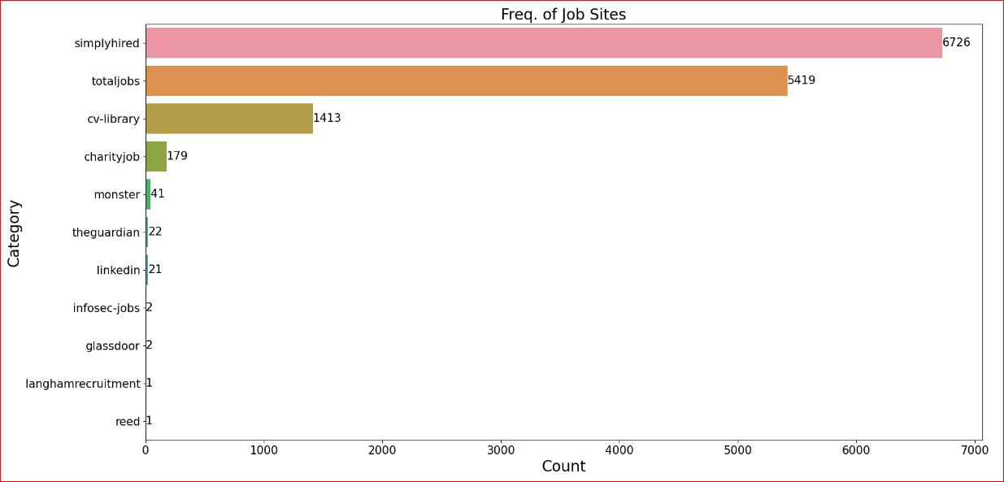
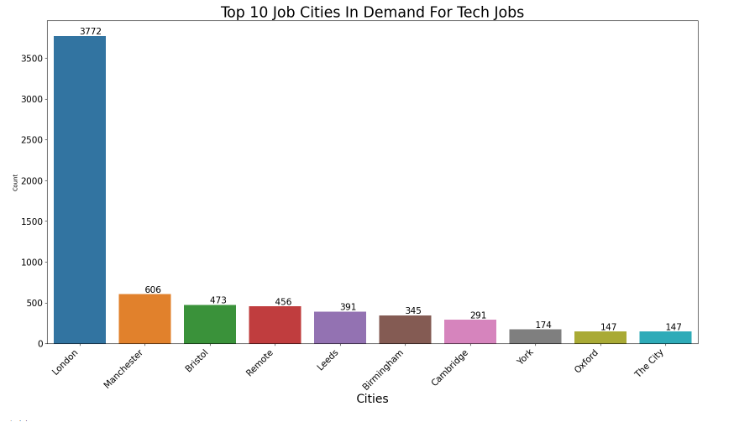
Frequent Job Sites /Job Cities
Simply Hired and Totaljobs are the most frequent job sites used across all Categories for Job search.
London is the city with the highest demand for tech jobs in the United Kingdom. It has 3,772 job listings

Slide 15
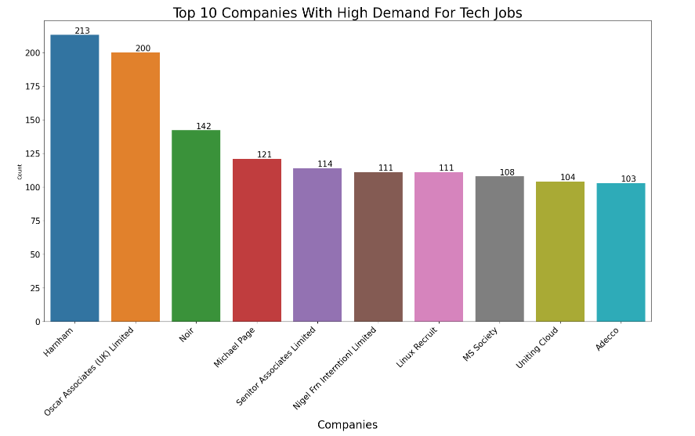
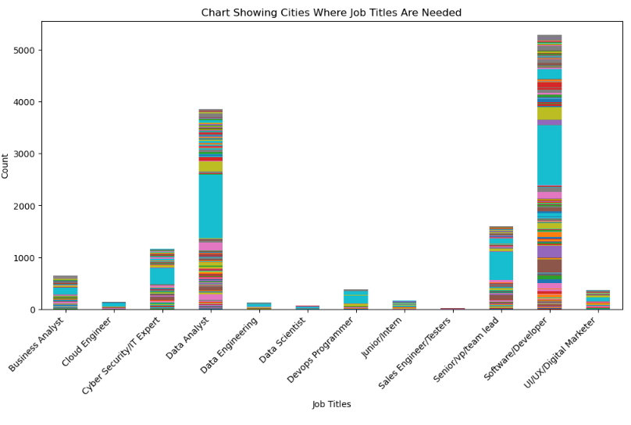
Jobs in Demand
In the UK, Harnham is the company with the most demand for tech jobs, with 213 job listings. Harnham are a specialist Data & Analytics recruitment business with teams that only focus on niche areas.
Software developers are in demand in more cities, followed by data analyst, while sales engineers are least demanded across all the cities

Slide 16
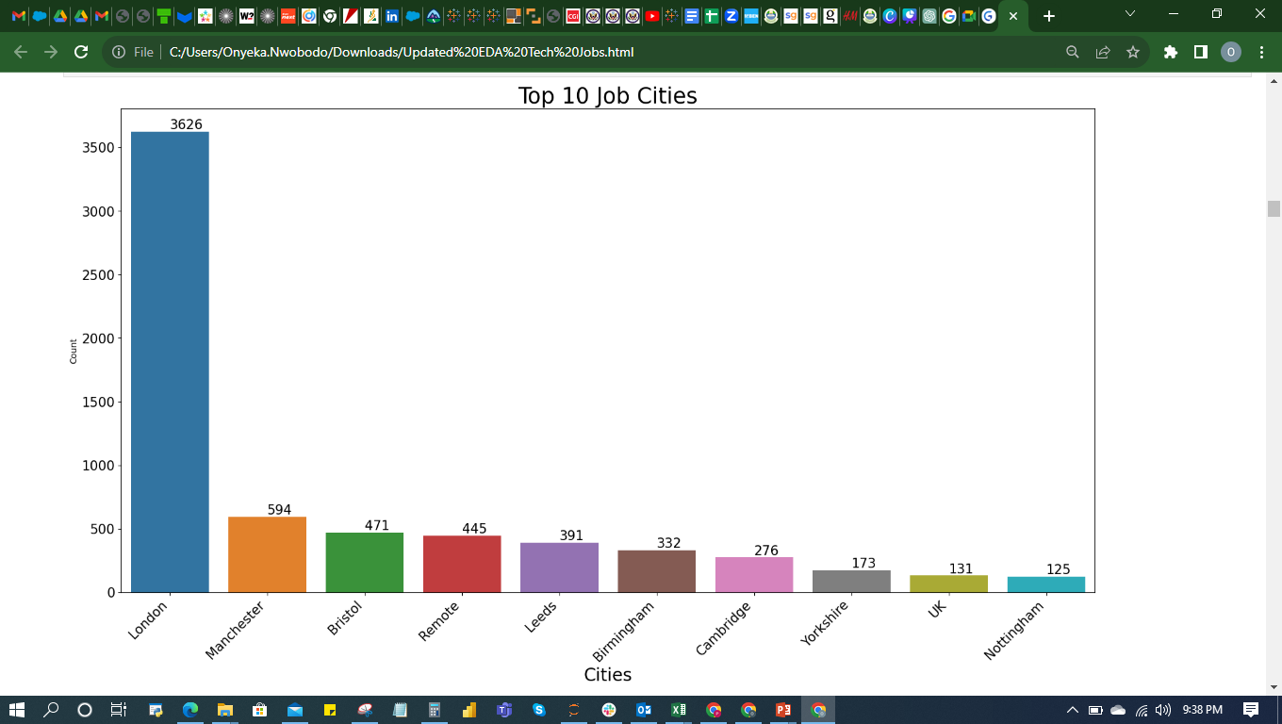
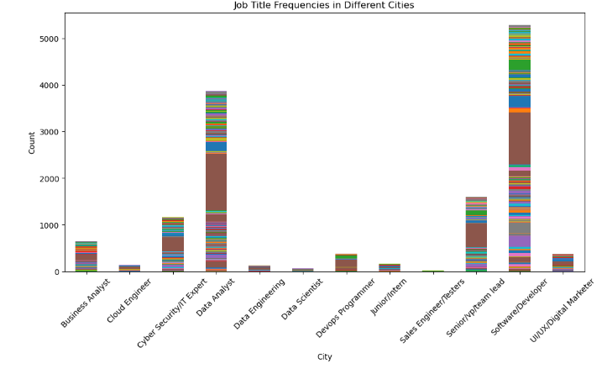
Frequent Job Cities /Frequencies
London shows to be the city with highest availability of Tech jobs, followed by Manchester and Bristol.
Software Developers, Data Analyst and Snr VPT/Team Leads are the job titles are demanded in more cities compared to others.

Slide 17
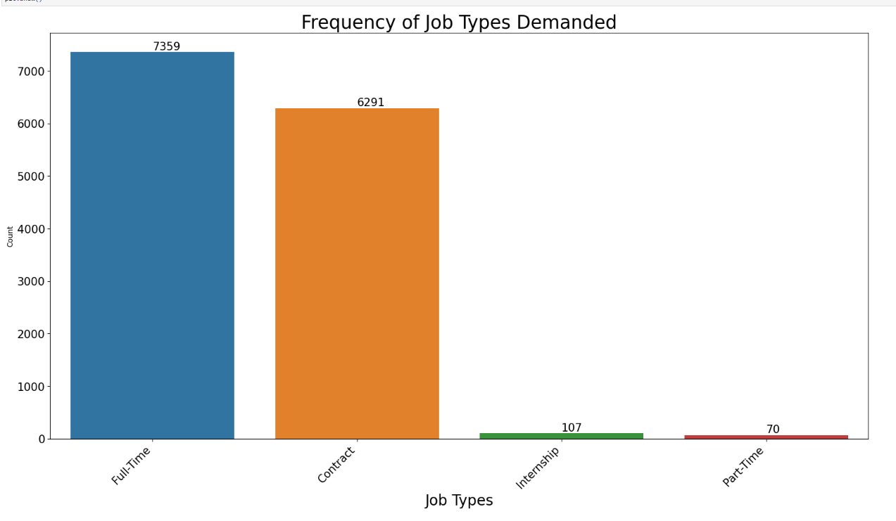
Job Type
Full time and contract employee are demanded the most by recruiters

Slide 18
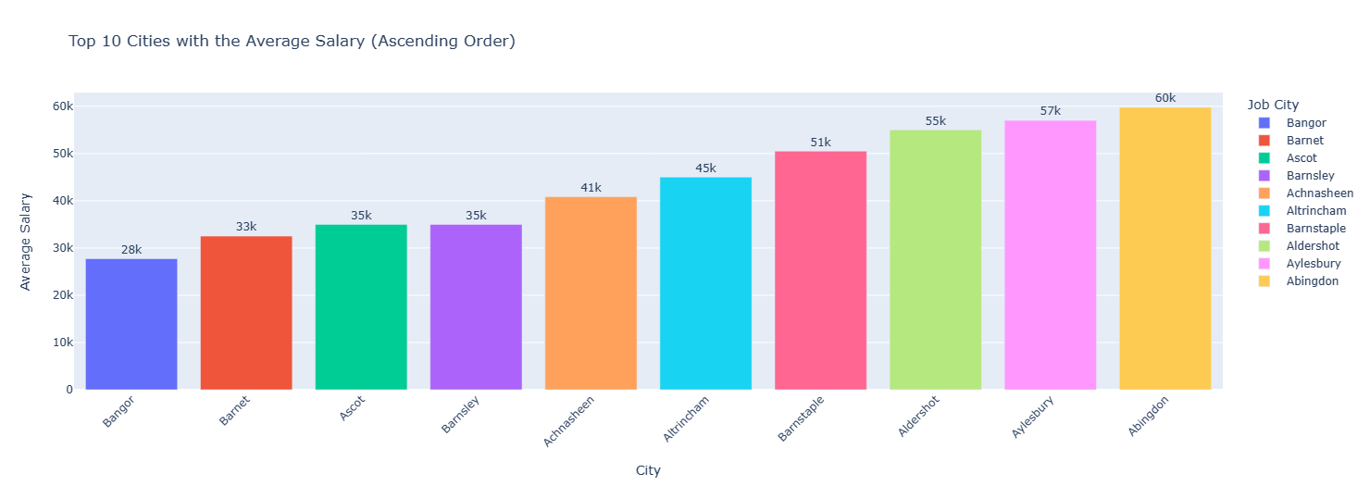
Job Cities and Average Salary for Job Seekers
Abingdon, Aylesbury and Aldershot has the highest Average salary for Tech job seekers

Slide 19
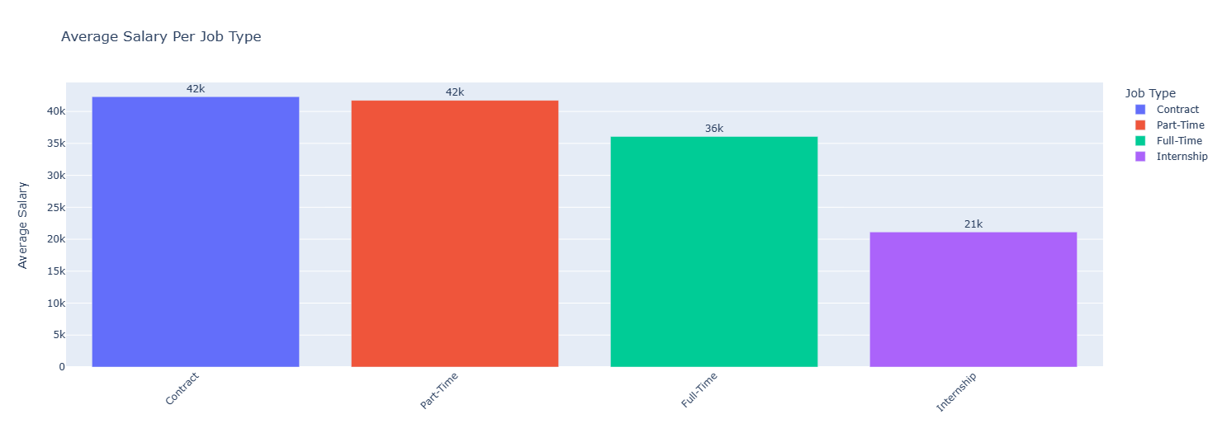
Average Salary for Job type
Contract has 42306 , part- time has 41741 and full-time has 36079

Slide 20
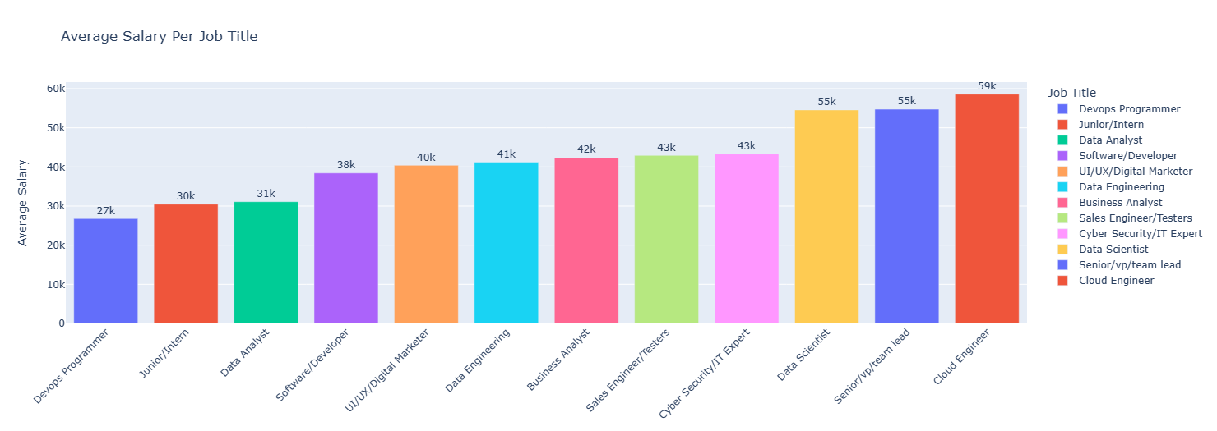
Average Salary for Job Titles
Cloud engineers on the average gets the highest salary (59,000 pounds), followed by Team lead and Data scientist (55,000 pounds).
Devops Programmer receives the least average salary amongst the job titles

Slide 21

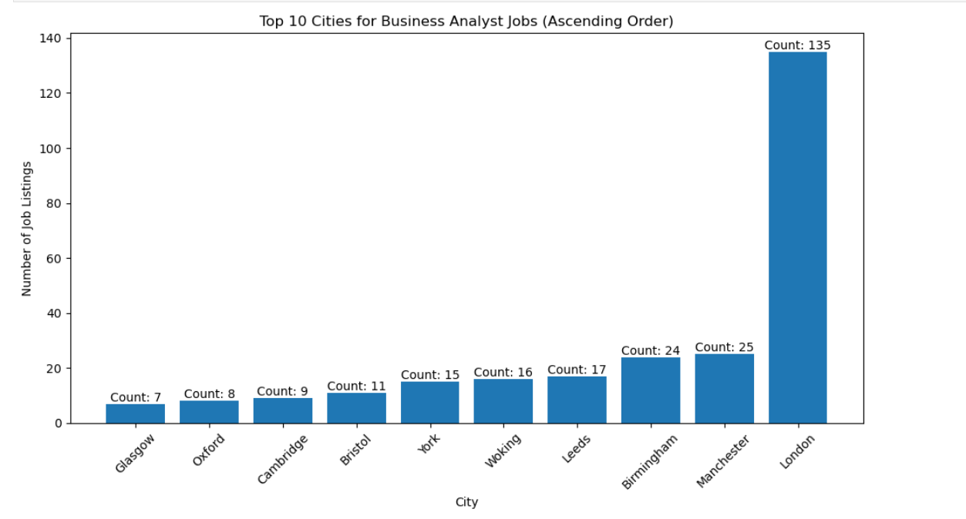
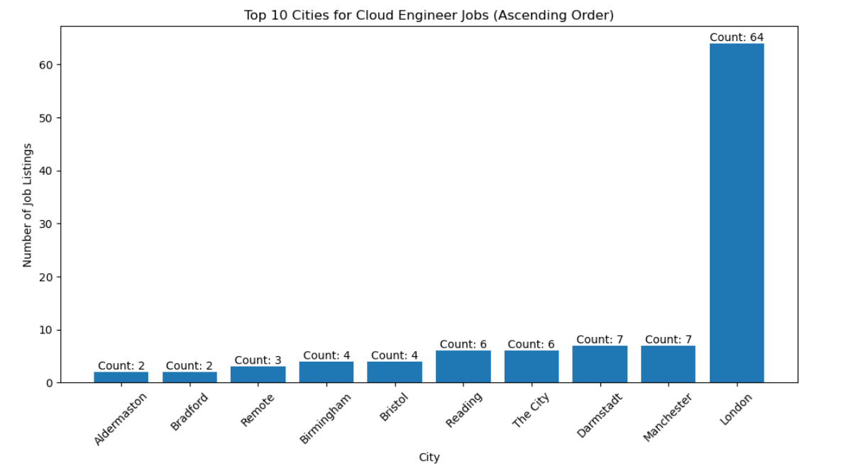
Top 10 Jobs and Cities demanding the Occupation- Business Analyst & Cloud Engineer
London has the highest demand for all job titles

Slide 22
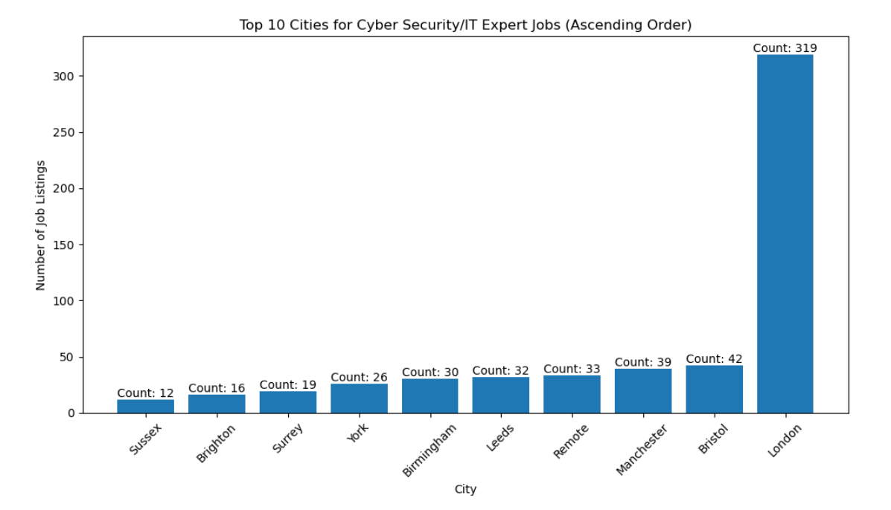
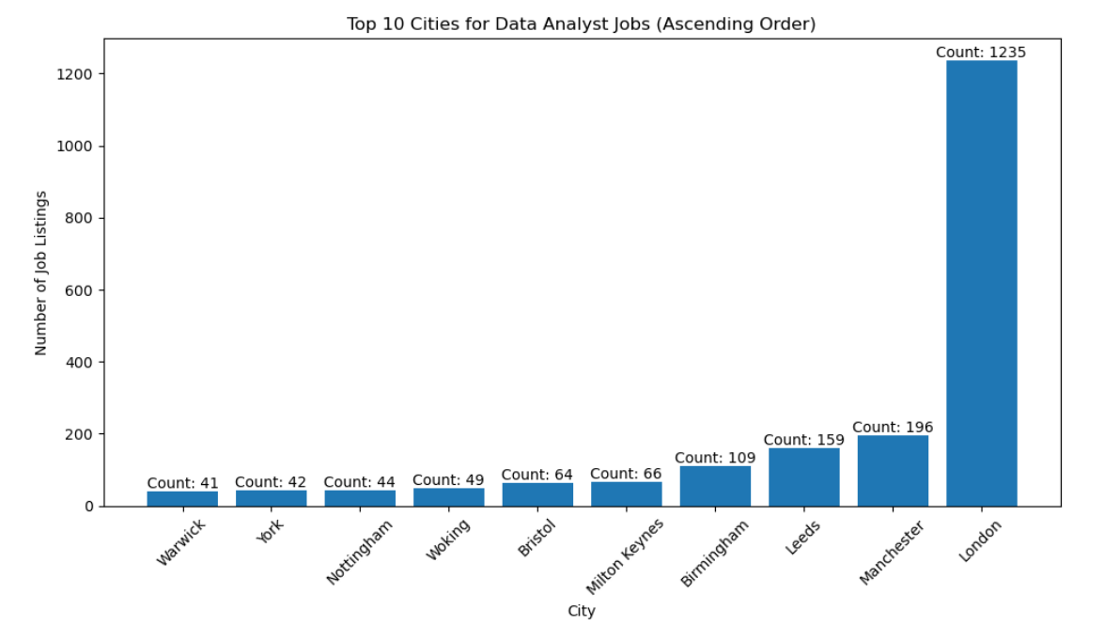
Top 10 Jobs and Cities demanding the Occupation- Cyber Security & Data Analyst
London has the highest demand for all job titles

Slide 23
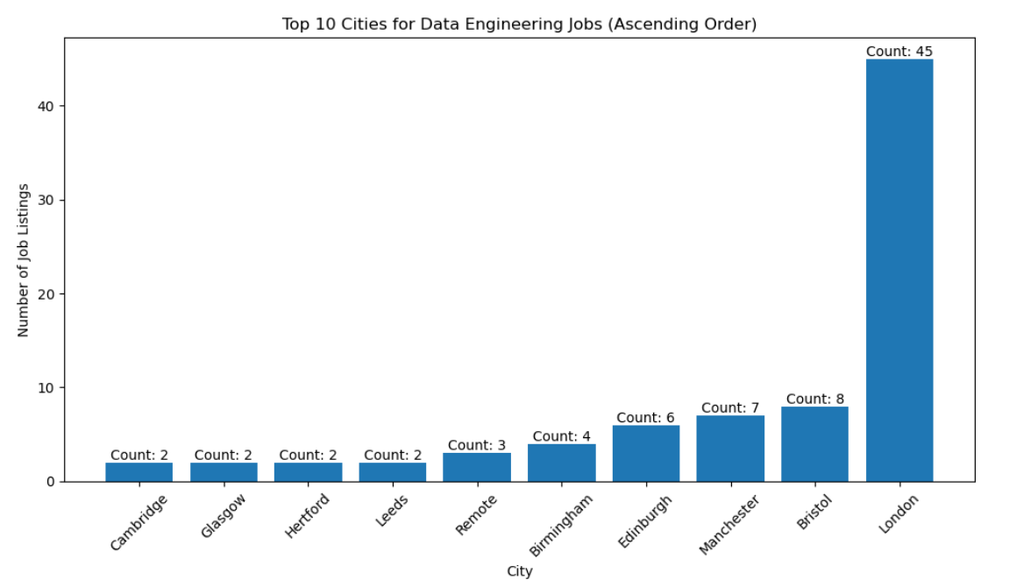
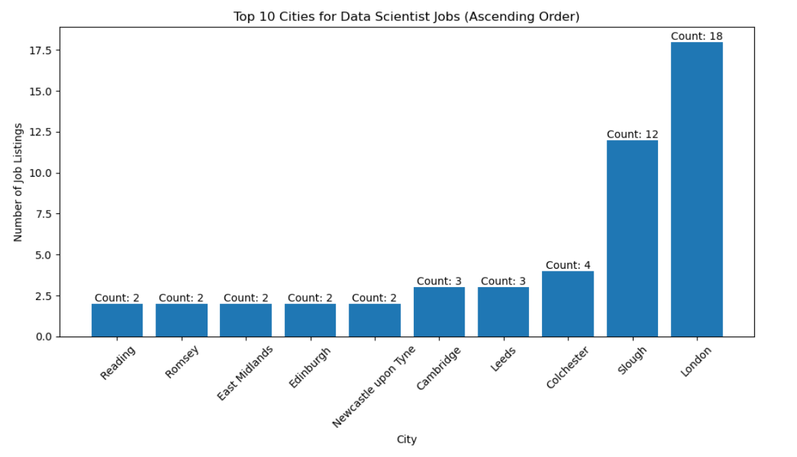
Top 10 Jobs and Cities demanding the Occupation- Data Engineering & Data Scientist
London has the highest demand for all job titles

Slide 24
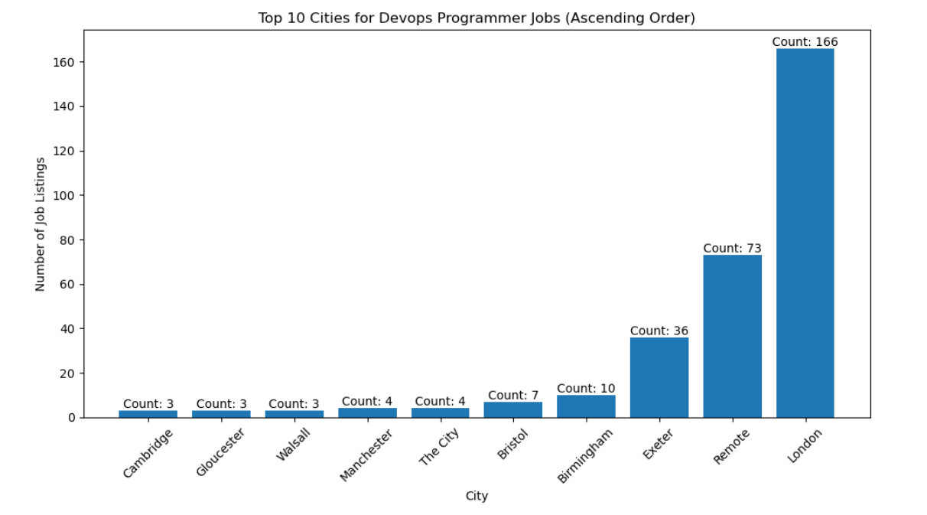
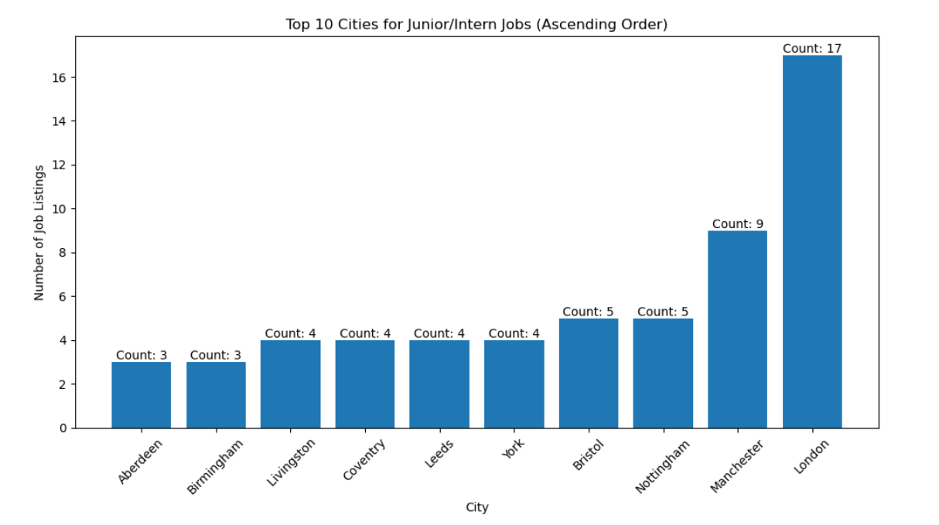
Top 10 Jobs and Cities demanding the Occupation- Programmer & Junior/Internship Jobs
London has the highest demand for all job titles

Slide 25
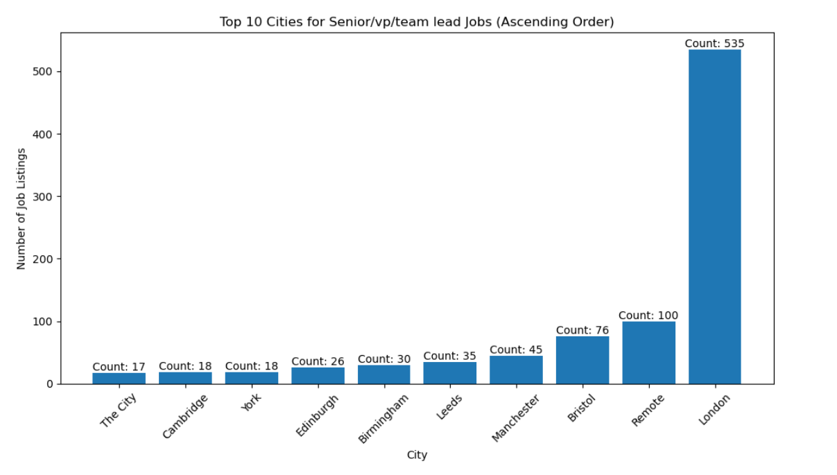
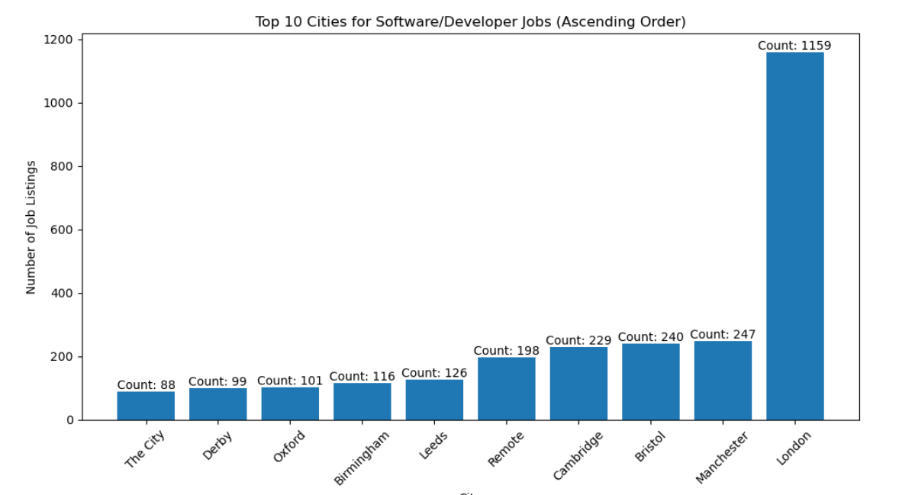
Top 10 Jobs and Cities demanding the Occupation- Senior Team Lead & Software Developer
London has the highest demand for all job titles

Slide 26
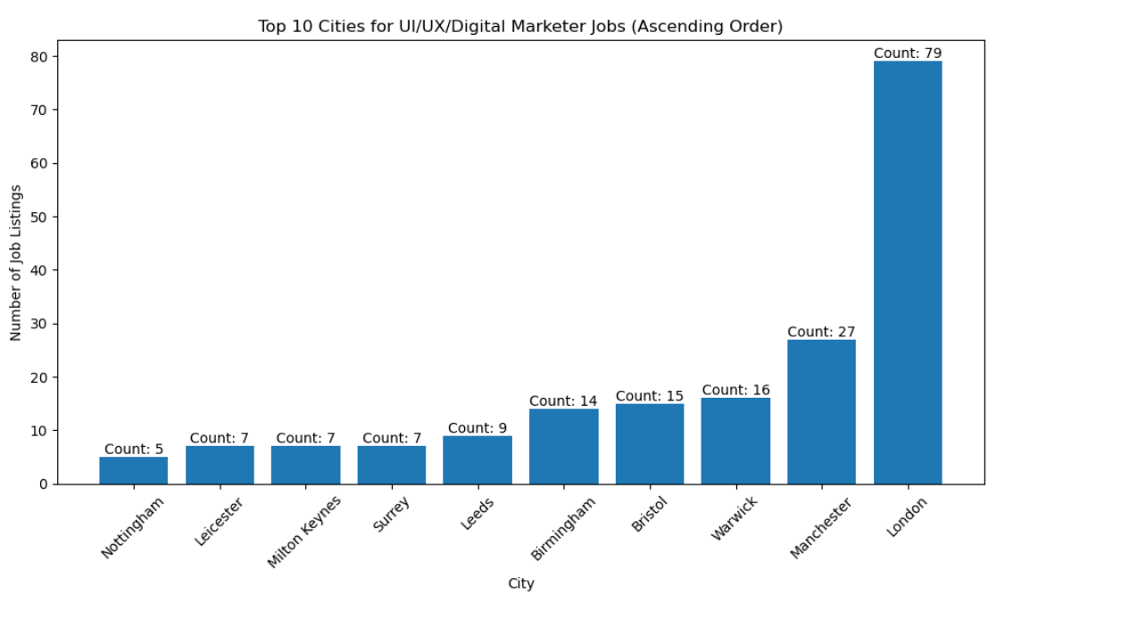
Top 10 Jobs and Cities demanding the Occupation- UI/UX/Digital Marketer
London has the highest demand for UI/UX/Digital Marketer

Slide 27
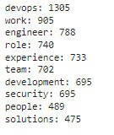
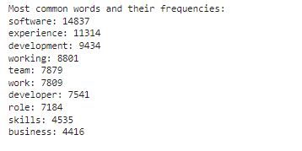
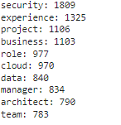
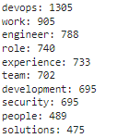
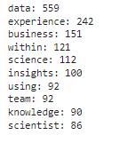
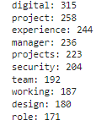
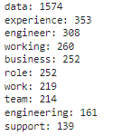
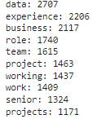
Job Key Words by Experience
Data Analyst
Devops Programmers
Software Developer
Cyber Security
Senior/Vp/team lead
Data Scientist
UI/UX/Digital Marketer
Data Engineering

Slide 28
Summary of the Data Set
Summary | There are 12 unique job titles under review There are 11 job types 11 job sites were placed under analysis 2,620 companies were observed 1,955 cities were also placed under review Software developer was the job title mostly in demand across all cities, 5,291 demands followed by data analysts and senior/lead roles in the tech space with 3,862 and 1,598 demands respectively. The job site mostly used according to the data by recruiters according to the data was simply hired, Totaljobs and cv-library with 6,726, 5,419 and 1,413 occurrences respectively. London city has the highest demand for tech jobs with 3,626 demands. The analysis revealed that Oscar Associates Limited, Hamham and Noir are the top 3 companies with high demand for tech roles, having 216, 213, and 142 demands respectively. Jobs requested for mostly i different cities vary, in London tech jobs mostly in demand are, Software developers, data analysts, team leads, UI/UX etc while in Leeds, data analysts and software developers etc Software developers are needed in more cities compared to other tech roles while software engineers are the least demanded by cities. Companies tend to demand mostly for temporary tech roles, followed by permanent and full-time respectively. The least job type demanded are contract/part-time and contract/temporary. All job titles have all job types in demand. The city of Doncaster on the average pays higher annual salary to techs. Temporary job types on the average gets 46,000 pounds, the highest average salary gotten in the category. Cloud Engineers receives the highest average salary of 59,000 pounds of all the job titles.

Slide 29

Insights
None of the cities with the top 10 average salaries offered to techies are not in the top 10 cities that demand for tech skills
In the UK, Harnham is the company with the most demand for tech jobs, with 213 job listings. Harnham are a specialist Data & Analytics recruitment business with teams that only focus on niche areas.
Software developers are in demand in more cities, followed by data analyst, while sales engineers are least demanded across all the cities
London shows to be the city with highest availability of Tech jobs, followed by Manchester and Bristol.
Software Developers, Data Analyst and Snr VPT/Team Leads are the job titles are demanded in more cities compared to others.

Slide 30

Recommendations
Job seekers seeking for tech jobs irrespective of the location should focus more of London as there are more job available there
Persons with skills in the least tech jobs in demand like sales engineer, data scientist, data engineer etc should endeavour that they upskill frequently to remain relevant and competitive in their field
Jobseekers looking for higher pay might want to consider cities like Abingdon, Aylesbury and Aldershot, they have the highest Average salary for Tech.
Professionals looking to transit or upskill into tech might want to consider software developer because they are in high demand
Recruiters /Employer demands more of fulltime staff but contract staff earns more

Slide 31
List of Participants On the Project
Business Analysts
Data Engineers
Data Scientists
Aderinmola Ojedokun
Nelson Avworo
Samson Adegbite
Temitope Akande
Kingsley Jolly Jackson
Vivian O. Oguadinma
Onyeka Nwobodo –Ereku
Eno Dan
Joseph Odeh
Boluwatife Ogunfowora
Wojuade Adetutu
Risikat Damilola Adelakun

Slide 32


